Slide 1
GROUP 5 | DS & AI LAB PROJECT
SerpentGuard AI: Snake Detection & Classification
Live Video Tracking, Calibrated Species ID and Offline Edge Models
Team Lead: Jayesh Bansal | Members: Vikas, Puneet Bajaj, Manas Rastogi

Slide 2

1. BACKGROUND & MOTIVATION
Why Snakes? Fine-Grained Field AI
Why It Matters
Real-World Urgency: India had an estimated 46,000 snakebite deaths in 2005 (Million Death Study, cited by WHO 2016); encounters trigger panic and snake killings.
Fine-Grained Vision: Look-alike species share patterns; blur, low light, and occlusion break generic models.
Safety First: Encourages a safe distance and never replaces a trip to the hospital.
Slide 2 | SerpentGuard AI: Motivation & Fine-Grained Scope

Slide 3
2. SCOPE, STAKEHOLDERS & MEASURABLE TARGETS
What We Build, For Whom, and How We Measure It
1. Scope
In Scope: 27 Indian species incl. the Big Four; photos + live video.
Out of Scope: Other species shown as unknown; no bite diagnosis.
2. Stakeholders
Users: Households, farmers, campus staff, snake rescuers.
Also: Forest dept., clinicians (education only), researchers.
3. Targets (M5)
Accuracy: Macro-F1 ≥ 0.80; top-3 ≥ 0.93; detector P and R ≥ 0.90.
Safety & Speed: Dangerous-species recall ≥ 0.95; ECE ≤ 0.05; ≥ 10 FPS.
Slide 3 | Targets are proposals until the Milestone 2 split exists; full list in the project report

Slide 4
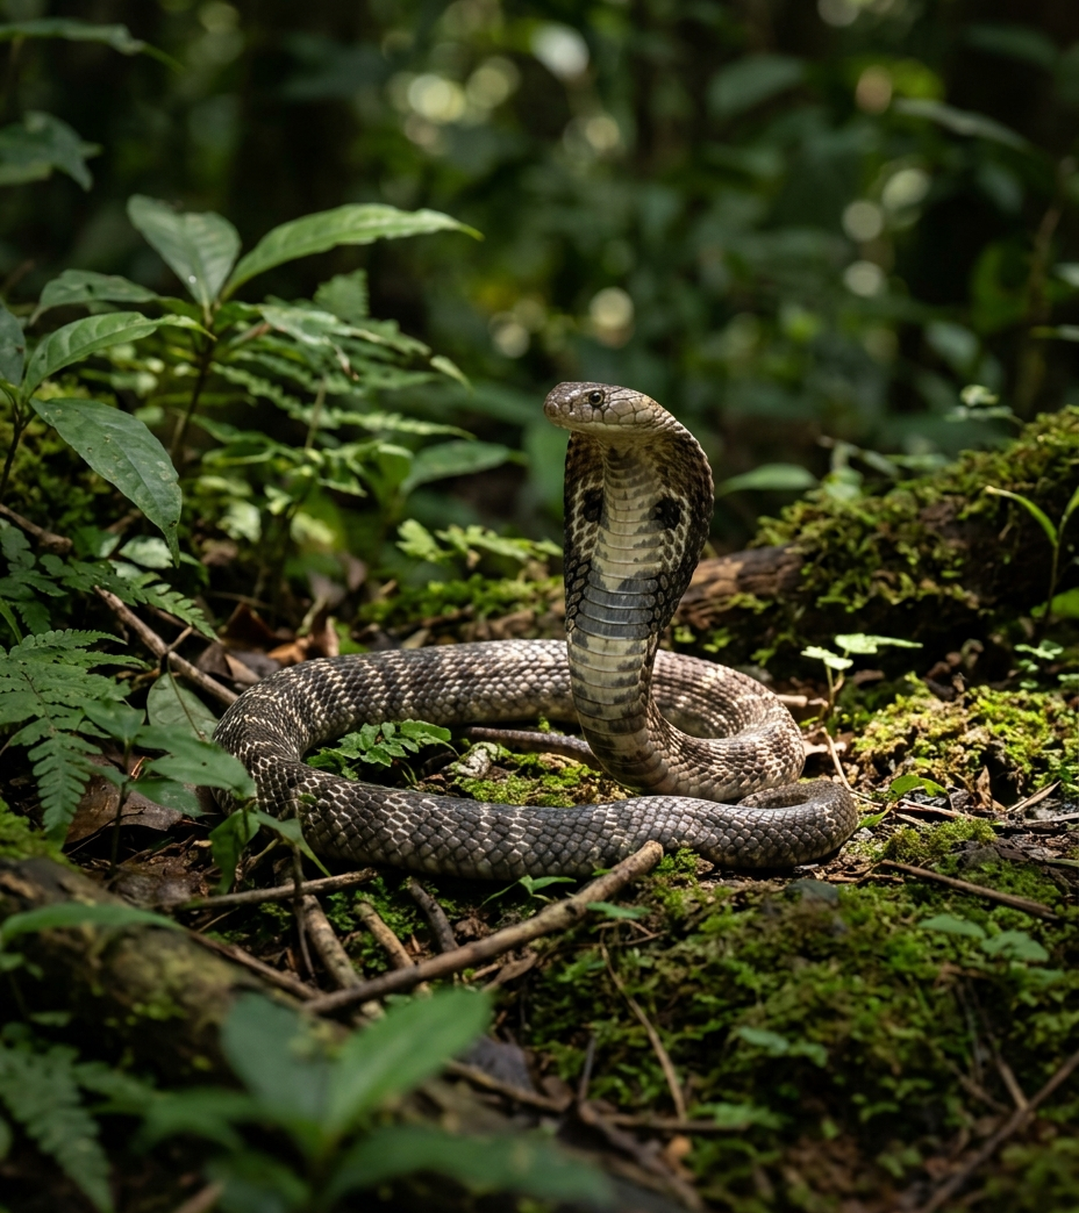
3. PRIMARY DIFFERENTIATOR BEYOND IMAGE UPLOAD
Live Camera Feed & Edge Safety
Live Video = Frame-by-Frame Vision
Same Model, Every Frame: YOLO finds and tracks the snake; the photo classifier labels each tracked crop.
Calibrated Abstention: Confidence thresholds flag ambiguous frames instead of forcing risky top-1 guesses.
Safety-First Guidance: Advises safe distance and local rescuers; never declares an area clear on missed views.
Slide 4 | Novel Scope: Real-Time Video Tracking

Slide 5
4. COMPARISON WITH EXISTING ALTERNATIVES
How SerpentGuard AI Differs From Cloud Search & Live LLMs
Capability | Google Search / Lens | Gemini / ChatGPT Live | Direct Cloud LLMs | SerpentGuard AI (Ours)
Primary Input | Static image upload | Cloud video streaming | Static prompt & image | Real-time local camera feed
Rural Offline Use | Needs internet | Needs a live connection | Needs internet + API | Offline edge model (target)
Fine-Grained Focus | General web matches | Generalist visual prior | Can sound sure when wrong | 27 Indian species, fixed list
Safety Abstention | Returns visual matches | No measured abstention | No calibrated confidence | Calibrated abstain + safety KB
Slide 5 | Design comparison, not yet measured: matched-image tests are planned for Milestone 5

Slide 6
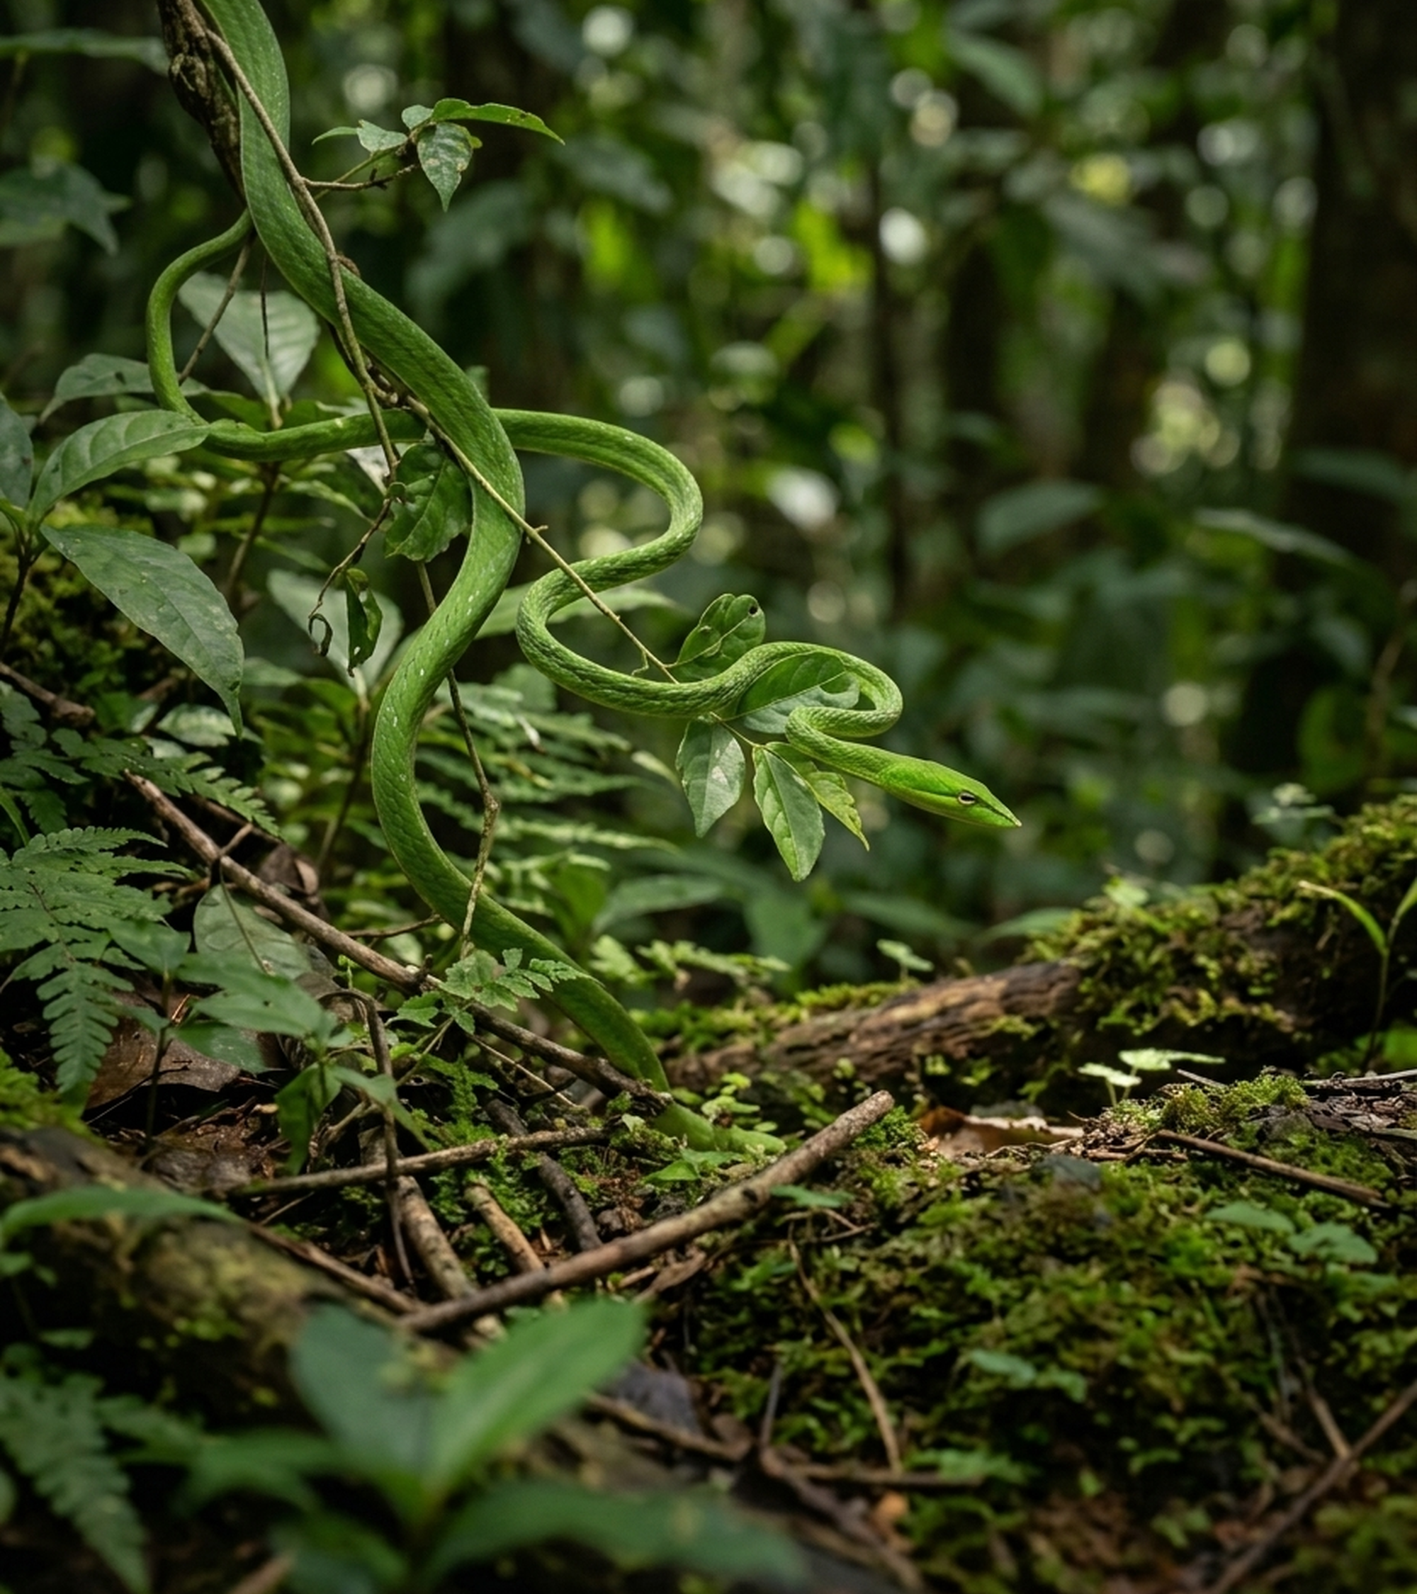
5. ACADEMIC LITERATURE & IMPLEMENTATION GAP
Beyond SnakeCLEF & YOLO Studies
What We Do Differently From Papers
SnakeCLEF (2021-2024): Strong ViT/CNN models, evaluated on static photos; live on-device video is outside the benchmark.
Prior YOLO Studies (2024-25): Report 87-88% detection precision but no calibrated abstention.
Two-Stage Edge Design: Couples real-time snake detection with calibrated fine-grained classification, offline.
Slide 6 | Sources: SnakeCLEF 2024; Naresh 2024; Najm 2025

Slide 7
6. SYSTEM ARCHITECTURE & OFFLINE DEPLOYMENT
Offline Edge Pipeline With No LLM APIs
1. Edge Detector
YOLOv8n (int8): Finds snakes in every live video frame.
ByteTrack: Keeps one ID per snake across frames.
2. Classifier
MobileViT: 27 Indian species; full fine-tune vs LoRA.
Abstention Gate: Calibrated thresholds + voting over recent frames.
3. Safety KB
No LLM APIs: No cloud latency or cost; no generated text.
Local Lookup: Species facts + official first-aid text, verbatim.
Slide 7 | Offline-First Architecture: Designed for Low-Connectivity Rural & Campus Environments

Slide 8
7. APPLICATION UI MOCKUPS (REAL-TIME EDGE EXPERIENCE)
SerpentGuard AI Interface: Live Detection & Abstention UI
Screen A: High-Confidence Detection
Live ROI & Top-3 Match: Illustrative: 1. Spectacled Cobra (0.86) | 2. Rat Snake (0.09) | 3. Russell's Viper (0.03).
Visual & Habitat Cues: Hood mark & dorsal pattern; facts from offline species KB.
Safety Quick Actions: [Official First-Aid Steps] and [Call Local Rescuer].
Screen B: Uncertain / Abstain Alert
Abstention Triggered: Confidence below threshold due to motion blur or foliage occlusion.
Look-Alike Caution: Ambiguous match between Common Krait and harmless Wolf Snake.
Mandatory Safety Guard: Do not approach snake: [Keep Safe Distance] and [Emergency Guide].
Slide 8 | UI Mockups (illustrative values): Live Bounding-Box Feed, Calibrated Top-3 & Safe Abstention

Slide 9
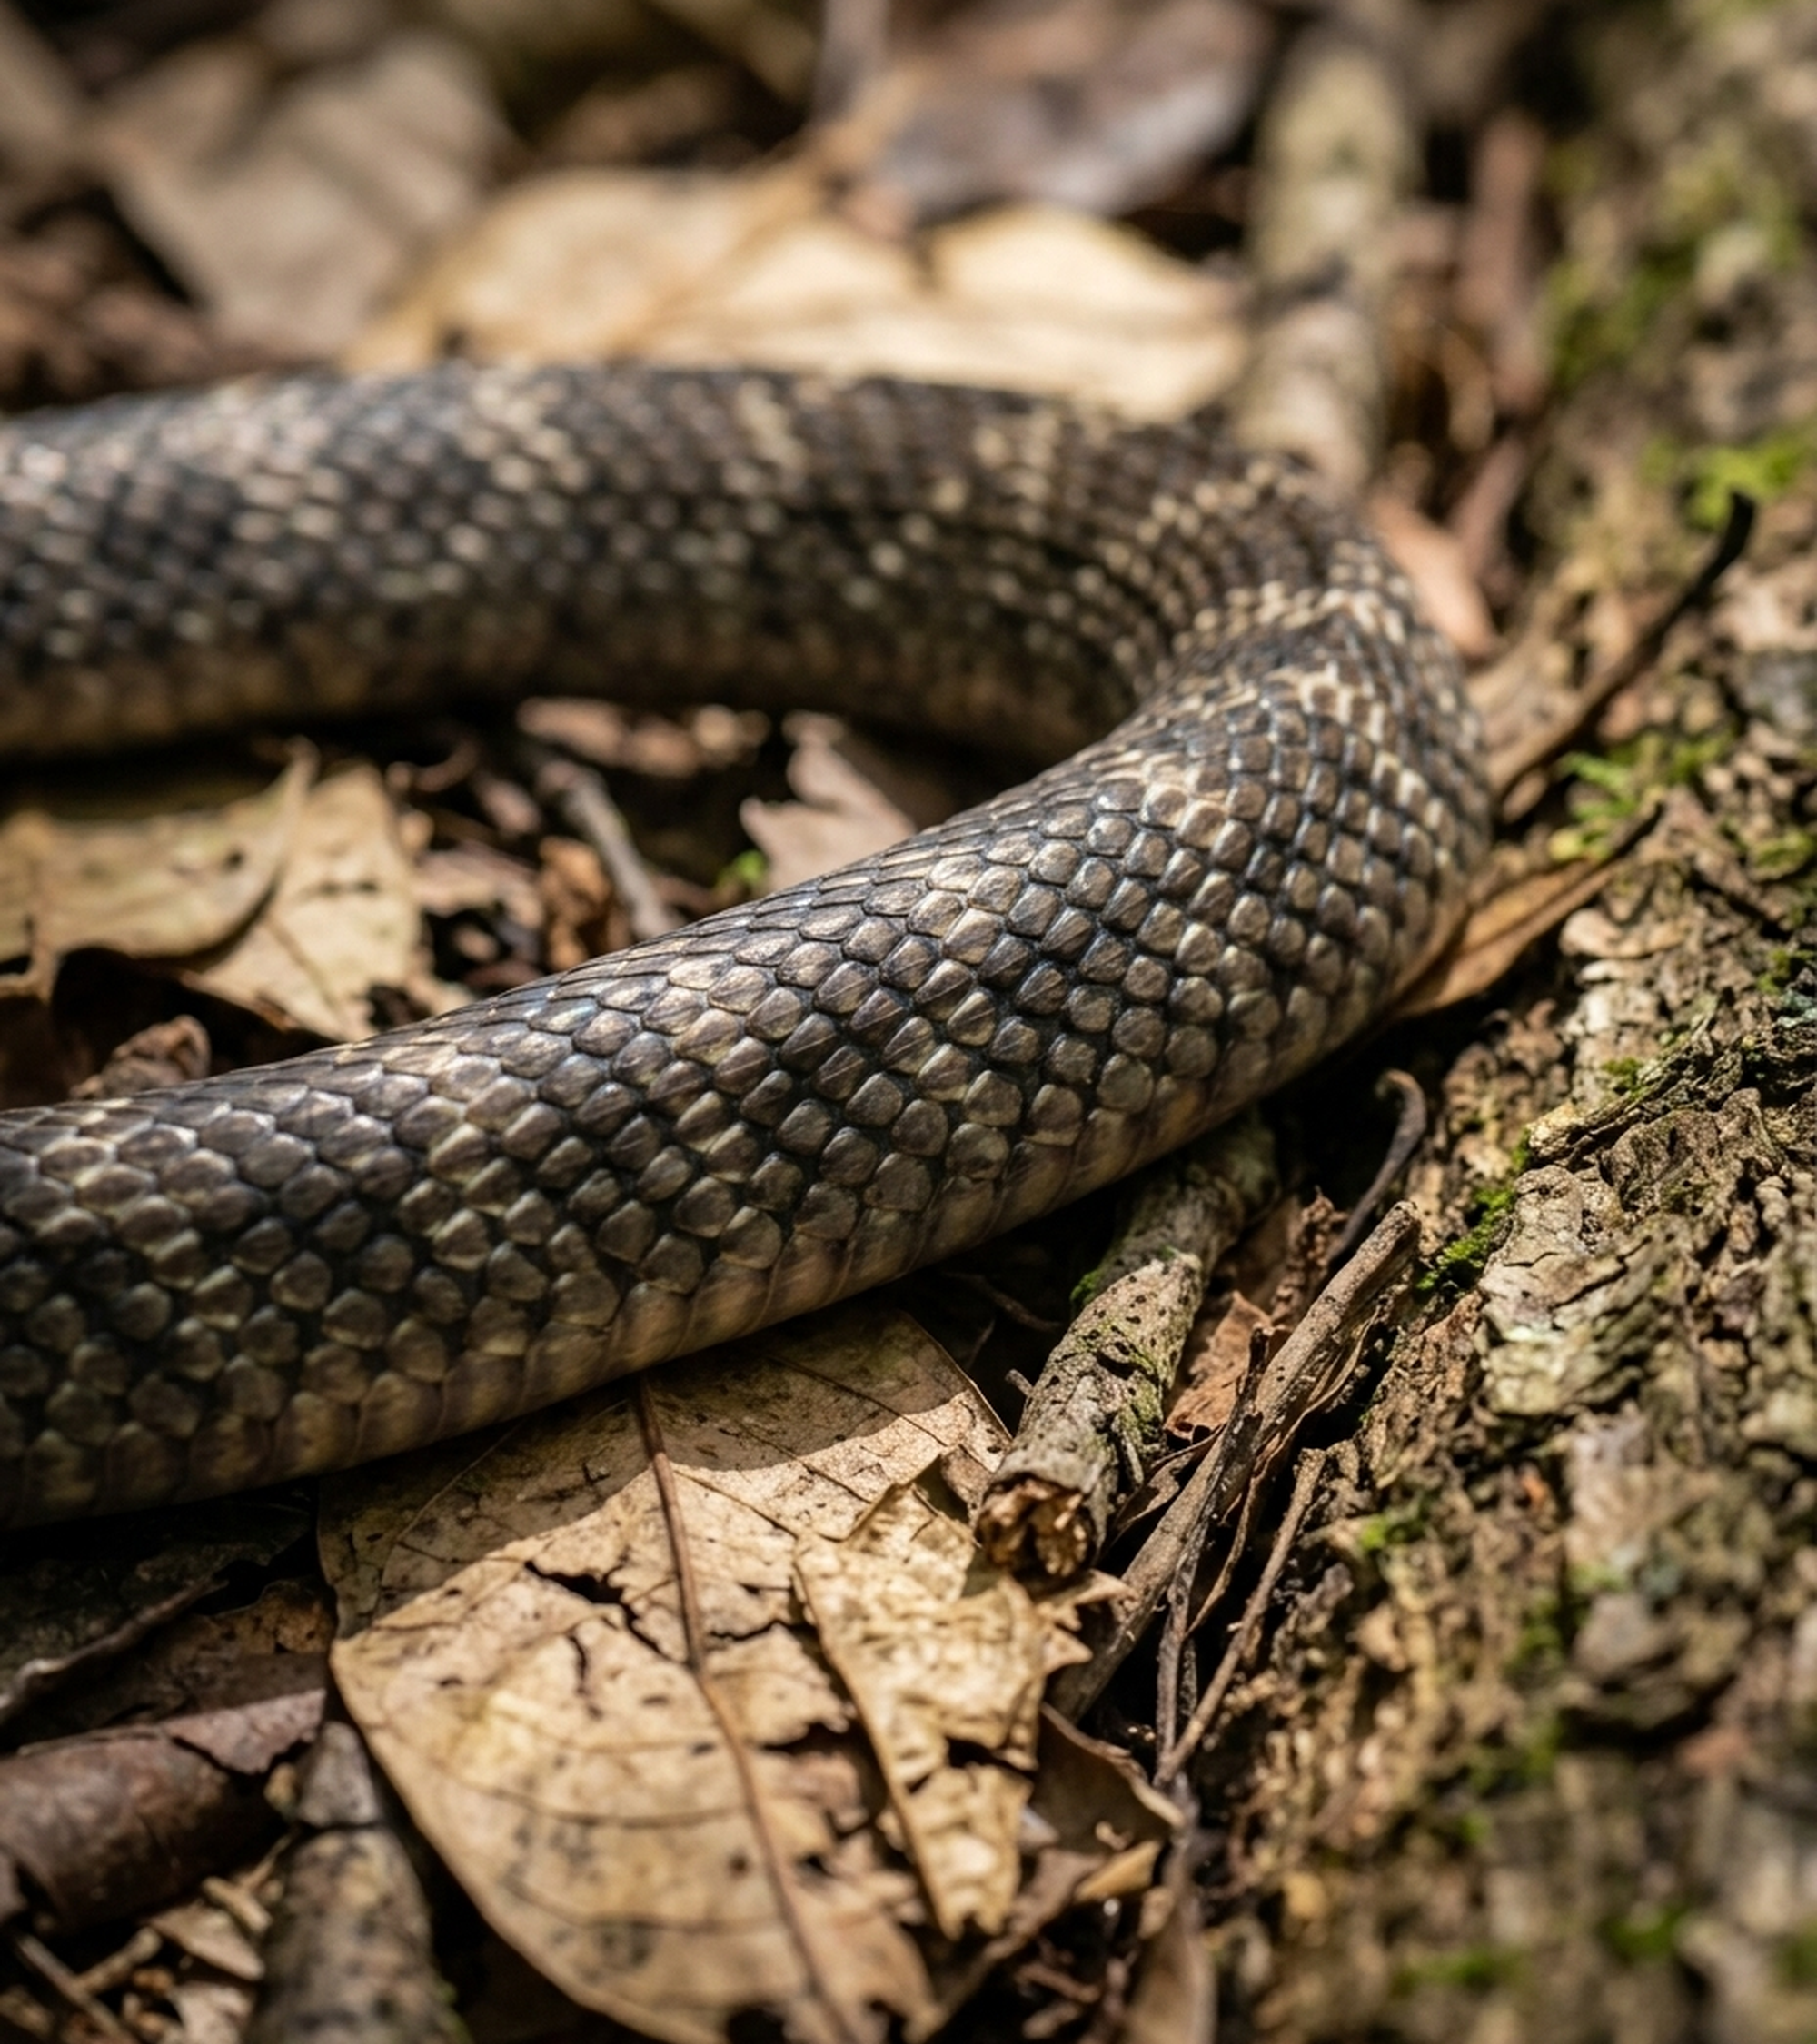
8. INVESTIGATING MODEL LIMITATIONS & EDGE CASES
Testing Occlusion & Calibration
Evaluation Protocol
Look-Alike Confusion: Quantifies confusion matrices between venomous snakes (Krait, Cobra) and mimics.
Degraded Visibility: Measures recall drops under motion blur, night light, and synthetic 30-70% occlusion.
Calibration Metrics: Evaluates macro-F1, per-species recall, and Expected Calibration Error (ECE).
Slide 9 | Empirical Validation: Occlusion & Calibration

Slide 10
9. ROADMAP & EVALUATION TARGETS
Build the Vision Pipeline First
Research Contributions
Core Vision First: The live frame-by-frame pipeline runs end-to-end on a data subset at Milestone 3.
Measurable Gains: Benchmarks LoRA fine-tuning and two-stage cropping against single-stage baselines.
Safety Governance: Validates abstention accuracy so missed detections never imply a safe environment.
Slide 10 | Literature: Naresh 2024, Najm 2025, Bolon 2022 (different datasets) vs. our Milestone 5 targets

Slide 11
Thank You. Questions?
SerpentGuard AI | Group 5, DS & AI Lab | Lead: Jayesh Bansal | Vikas, Puneet Bajaj, Manas Rastogi

